Slide 1

50.039 Theory and Practice of Deep Learning W1-S1 Introduction
Matthieu De Mari

Slide 2

A quick word about instructors
Matthieu (Matt) De Mari
Lecturer at SUTD (Python, Deep Learning, AI, and more)
Information Systems Technology and Design (ISTD) pillar/faculty
PhD from CentraleSupelec (France)
Email: matthieu_demari@sutd.edu.sg
Office @ SUTD: 2.401.07

Slide 3
A quick word about TAs
XXX
XXX

Slide 4
Skills needed for this course
Must-have CS: Python, Numpy, Matplotlib.
Must-have Math: Linear Algebra, multiple variables calculus, derivatives, optimization probability and statistics.
Good-to-have CS: Machine Learning, Data Processing, Scipy, Sklearn.
Good-to-have Math: Graph Theory, Game theory.
Need to revise? Time to check your 10.014 CTD, 10.013 M&A, 10.018 MS&S, 10.022 MU, 10.020 DDW, and 50.007 ML!

Slide 5
Objectives of 50.039 DL
Introduce the technical aspects related to the implementation of Deep Neural Networks from scratch.
Teach the students about the most popular framework for implementing Deep Neural Networks (as of Jan 2023): PyTorch.
Discuss the mathematical foundations and intuitions behind the Deep Learning framework, layers and some techniques.
Give the students a global overview of the advanced techniques related to Deep Learning and Deep Neural Networks.
Describe examples of practical applications of Deep Learning, showing how some key AIs were implemented using Deep Learning.

Slide 6
Objectives of 50.039 DL
Eventually, assemble all concepts and tricks of the trade discussed in this course to produce big architecture models that are close to the current state-of-the-art ones (e.g. ChatGPT, Dall-E, etc.).
Discuss ethical aspects related to some of the concepts discussed.
Give students an understanding of the current state of research in the Deep Learning community, and more specifically pointers as to where the most up-to-date information can be found.
This includes tracking big names in the field, identifying key scientific papers that have changed the field, but also newsletters, websites or magazines that disclose information in layman terms.

Slide 7
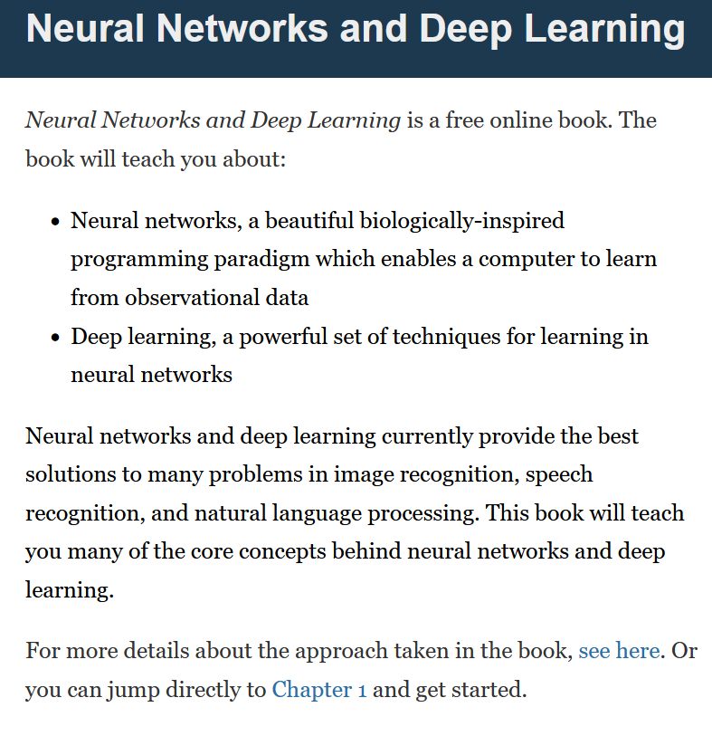
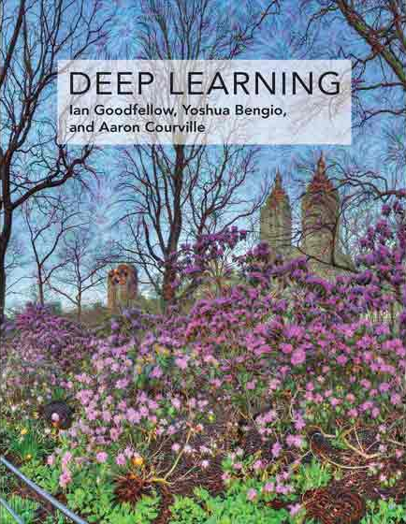

Supporting Textbooks
Supporting textbooks, for your curiosity (not needed to understand this course).
Michael A. Nielsen, “Neural networks and deep learning”, 2015. (http://neuralnetworksanddeeplearning.com/)
Ian Goodfellow, Yoshua Bengio and Aaron Courville, “Deep learning”, 2016. (https://www.deeplearningbook.org/)
Stevens et al., “Deep Learning with PyTorch”, 2020. (https://www.manning.com/books/deep-learning-with-pytorch)

Slide 8
Syllabus
Week 1: Introduction to course, some ML jargon reminders, linear and polynomial regression, generalization, ridge regression and regularization, overfitting/underfitting, logistic regression, neurons objects and how they relate to biology, our first shallow neural network, gradient descent reminders, training and testing procedure.
Week 2: Introduction to PyTorch framework, tensors and dataloaders, implementing a shallow neural network in PyTorch, backpropagation in PyTorch with AutoGrad, advanced optimizers, multi-label classification with shallow neural networks, moving from shallow to deep neural networks.

Slide 9
Syllabus
Week 3: Guided project and good practices for Deep Learning projects (train/test/dev, bias/variance, advanced regularization, dropout, normalizing inputs/outputs/layers, trainer functions, savers/loader functions for reproducibility and transfer learning).
Week 4: The image data type, image processing techniques and typical computer vision operations, the convolution operation and layers, Convolutional Neural Networks, advanced CNNs and SotA. Preparing transition to the 50.035 Computer Vision course.

Slide 10
Syllabus
Week 5: Sequential data (times series, text, etc.), vanilla Recurrent Neural Networks, Gated Recurrent Units, Long-Short Term Memory cells, advanced RNN networks, mixing models for advanced architectures and project announcement.
Week 6: Adversarial machine learning, attacking a Neural Network with basic gradient-based attacks, fundamental limits of Neural Networks, defense mechanisms and state-of-the-art of some advanced attacks techniques. MidTerm exam (based on W1-5).

Slide 11
Syllabus
Week 8: The embedding problem, more advanced concepts on RNNs, introduction to Natural Language Processing (NLP) and Word Embeddings for NLP, brief state-of-the-art on NLP, attention and transformers architectures. Preparing transition to the 50.040 Natural Language Processing course.
Week 9: Quick introduction to Graph Theory and typical graph datasets and problems, basics of Graph Convolutional Networks, brief state-of-the-art of advanced Graph Convolutional Networks.

Slide 12
Syllabus
Week 10: Generative Models, Autoencoders and Variational Autoencoders, Generative Adversarial Networks (GANs), Advanced concepts on Generative Adversarial Networks, Practice on GANs.
Week 11: Brief introduction to reinforcement learning, and state-action-rewards systems, multi-armed bandit problem and the exploration/exploitation trade-off, Q-learning and Deep Q-Learning. Brief state-of-the-art discussion about further works in Reinforcement Learning.

Slide 13
Syllabus
Week 12: Explainability/Interpretability and open questions in research about Neural Networks. Deep belief models and diffusion models. What will be the next revolution in AI? (a word on ChatGPT, Dall-E, etc.). Closing and future directions for studying Deep Learning.
Week 13: Recap. Project presentations and guest conferences (TBA).
Week 14: Final exam (probably W1-13).

Slide 14
The way I teach things

Slide 15
Evaluation and grading
Homeworks (29%): Given on Weeks 2, 5, 8, 10. Usually come in the form of a Jupyter Notebook, containing explanations, code snippets and questions. Submissions on eDimension, two weeks later or so, as a small PDF report containing code, figures and answers to questions. When time allows, debrief of homeworks in class.
MidTerm Exam (20%): Given on Week 6, March 1st 2023. Theoretical, paper exam, notions of Week 1-5 to be tested. More details about venue and exam details to be announced closer to the exam date.

Slide 16
Evaluation and grading
Final Exam (20%): Given on Week 14, April 26th 2023. Theoretical, paper exam, notions of Week 1-13 to be tested. More details about venue and exam details to be announced closer to the exam date.
Project (29%): Groups of 2-3 students. Submission for project (code, report, presentation) expected on Week 13. Problem statement to be freely decided by students, as long as it matches a list of given requirements. We will have a guided demo project on Week 3, more details about the project will be given on Week 5.
Student Feedback Survey (2%): the usual.

Slide 17



Technical pre-requisites
Install Python 3, if you have not done so already (this course does not cover C++/Java).
Libraries needed (maybe more based on projects/homeworks): numpy, matplotlib, scipy, sklearn, networkx, pillow, gym.
Jupyter notebooks for demos of code, along with the slides.
In doubt, you can always use Google Colab to run the codes.

Slide 18

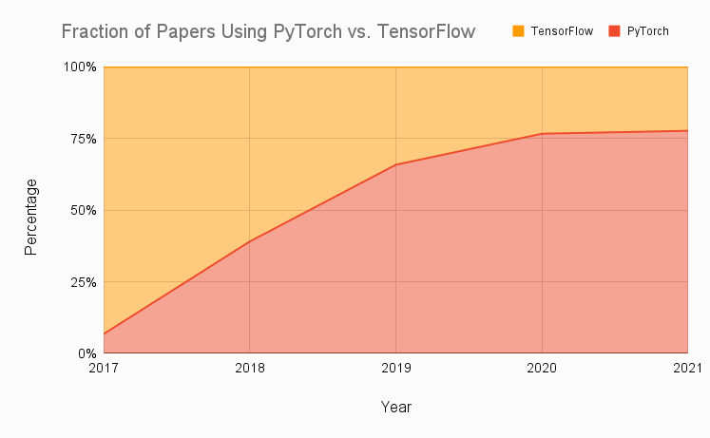
Technical pre-requisites
Framework of choice will be PyTorch! (not Tensorflow, not Keras, not MXNet, etc.)
Increasing popularity and preferred to Google’s Tensorflow these days for many reasons.
Learn more, if curious: https://www.assemblyai.com/blog/pytorch-vs-tensorflow-in-2022/

Slide 19
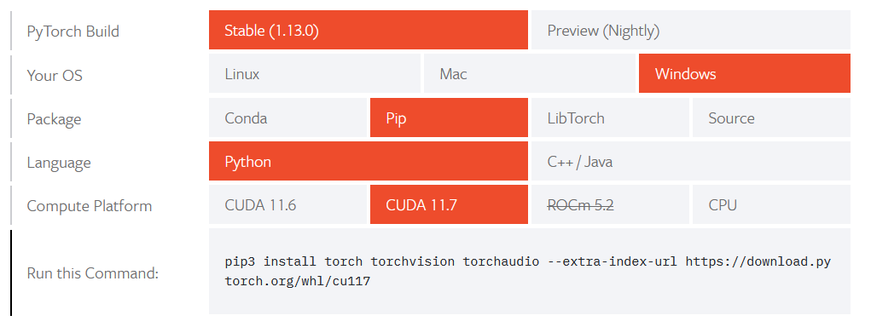
Installing PyTorch and CUDA
Install PyTorch, by getting the right version from https://pytorch.org/get-started/locally/

Slide 20
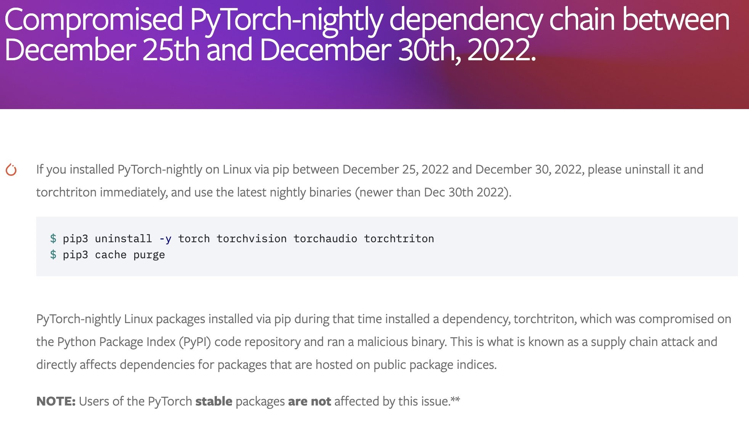
Installing PyTorch and CUDA

Slide 21
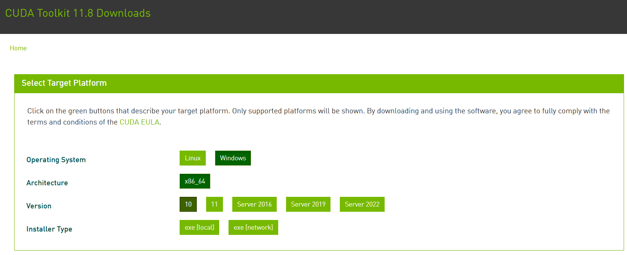
Installing PyTorch and CUDA
Check if your GPU is in the list of acceptable GPUs. https://developer.nvidia.com/cuda-gpus
If so, install CUDA (check version number matches PyTorch install!) https://developer.nvidia.com/cuda-downloads

Slide 22
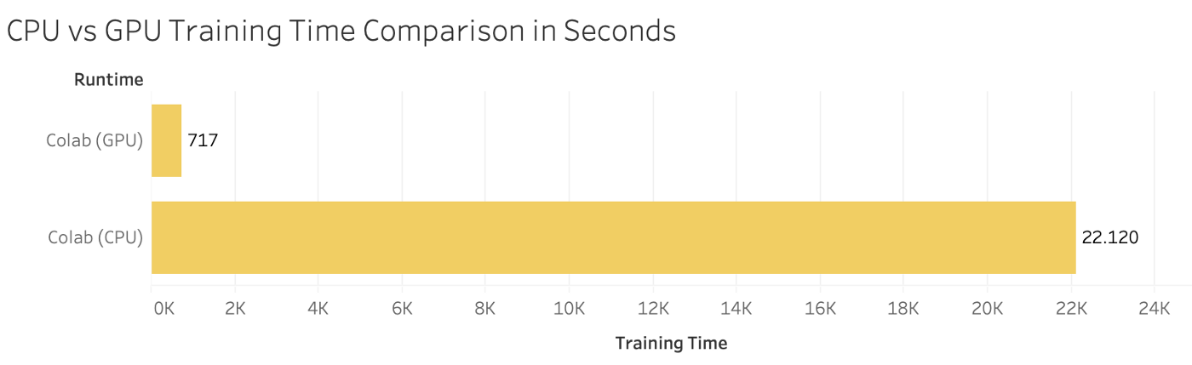

Installing PyTorch and CUDA
GPU not in the list of CUDA-enabled GPUs? Most notebooks can still run on CPU (but they might take significantly longer).
Always the option of using Google Colab, or create an education account on AWS.

Slide 23
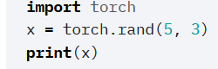
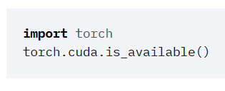
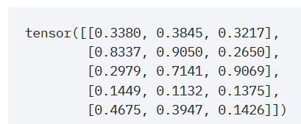
Checking your PyTorch and CUDA install
Hello World for PyTorch: to check you have PyTorch installed correctly. The code below should run and display a tensor.
Hello World for CUDA: to check you have correctly installed CUDA on top of PyTorch. The code below should print True, as the output of torch.cuda.is_available()

Slide 24

A quick word about PyTorch 2.0
PyTorch 2.0 has been announced end of 2022 and will have several new features, including
torch.compile(), which allows for faster training,
and the ability to move parts of the PyTorch framework from C++ back into Python.
It will also be cloud-agnostic, open-source.

Slide 25
A quick word about PyTorch 2.0
PyTorch 2.0 is currently still in its experimental phase. Stable PyTorch 2.0 release date is slotted for March 2023.
(Some nightlies releases are available, but I would advise against using them for now!
Allow me to explore it a bit more first and let us discuss it again in Week 13!)

Slide 26
About this week (Week 1)
XXX

Slide 27
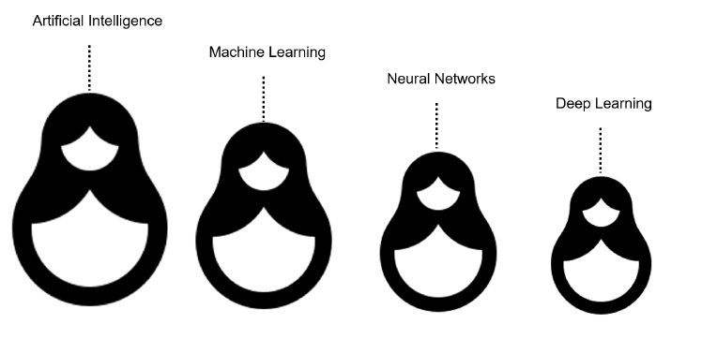
What is AI/ML/NN/DL?
Artificial intelligence
Machine Learning
Neural Networks
Deep Learning
Definition (Artificial Intelligence):
“In Computer Science, Artificial Intelligence (AI) refers to the theory and development of computer systems capable to perform cognitive tasks that normally require human intelligence, such as visual perception, speech recognition, decision-making, and translation between languages.”

Slide 28
What is AI/ML/NN/DL?
Conventional programming
Definition (Machine Learning):
In Computer Science, Machine Learning (ML) refers to the field of study that describes techniques and algorithms that give computers the ability to learn without being explicitly programmed.
Some implementations of machine learning may rely on data and neural networks.
- Arthur Samuel (1959).
Input (Given)
Function
(Created)
Output
(Obtained)
VS.
Machine Learning
Input (Available)
Function
(?)
Output
(Available)

Slide 29
What is AI/ML/NN/DL?
What we have done in programming so far was to design functions,
which would do specific operations,
and return outputs,
for any input we could give it.
But sometimes, we can encounter problems where
we can easily find inputs and expected outputs,
but the function to be coded is not simple to figure out.
E.g., what animal is in the picture?
Input (Given)
Function
(Created)
Output
(Obtained)
Input (Available)
Function
(?)
Output
(Available)

Slide 30

What is AI/ML/NN/DL?
E.g., what animal is in the picture?
Typical problem in Computer Vision, called Image Recognition.
Input x (available)
Function f
(?)
Output y = f(x)
(available)
It’s a cat!

Slide 31
What is AI/ML/NN/DL?
E.g., what animal is in the picture?
Typical problem in Computer Vision, called Image Recognition.
Input x (available)
Function f
(?)
Output y = f(x)
(available)
Very easy for a human…
But, how would we do it with a computer?
It’s a cat!

Slide 32
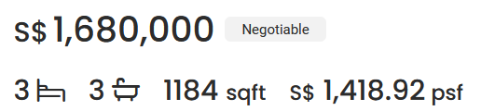
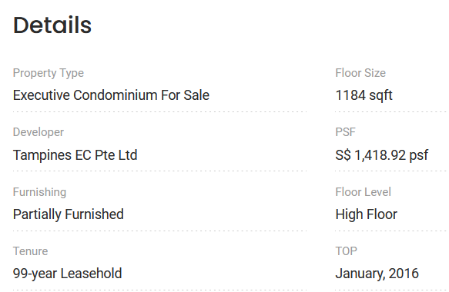

What is AI/ML/NN/DL?
Other scenarios of difficult functions have to do with tasks where there is no easy closed-form expression connecting inputs to outputs.
E.g., what is a good selling price for my appartment?
Guessing the selling price of an appartment based on its parameters (size, location, etc.) and previous sales.

Slide 33

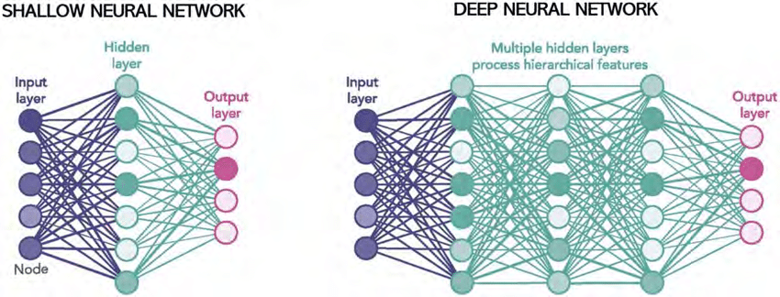
What is AI/ML/NN/DL?
Definition (Neural Networks):
Neural Networks (NNs) are computing systems inspired by the biological neural networks that constitute animal brains.
NNs are based on a collection of connected units or nodes called artificial neurons, which loosely model the neurons in a biological brain.

Slide 34
What is AI/ML/NN/DL?
Definition (Neural Networks):
Neural Networks (NNs) are computing systems inspired by the biological neural networks that constitute animal brains.
NNs are based on a collection of connected units or nodes called artificial neurons, which loosely model the neurons in a biological brain.
Each connection, like the synapses in a biological brain, can transmit a signal to other neurons, therefore processing any information given as inputs to produce a final signal as output.

Slide 35
What is AI/ML/NN/DL?
Definition (Deep Learning):
Deep Learning (DL) is a subfield of machine learning, and deep neural networks make up the backbone of deep learning algorithms.
The number of node layers, or depth, of neural networks is what distinguishes a shallow neural network from a deep neural network, which must have more than three.

Slide 36
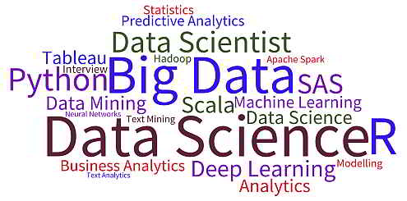
What is AI/ML/NN/DL?
Artificial intelligence
Machine Learning
Neural Networks
Deep Learning

Slide 37
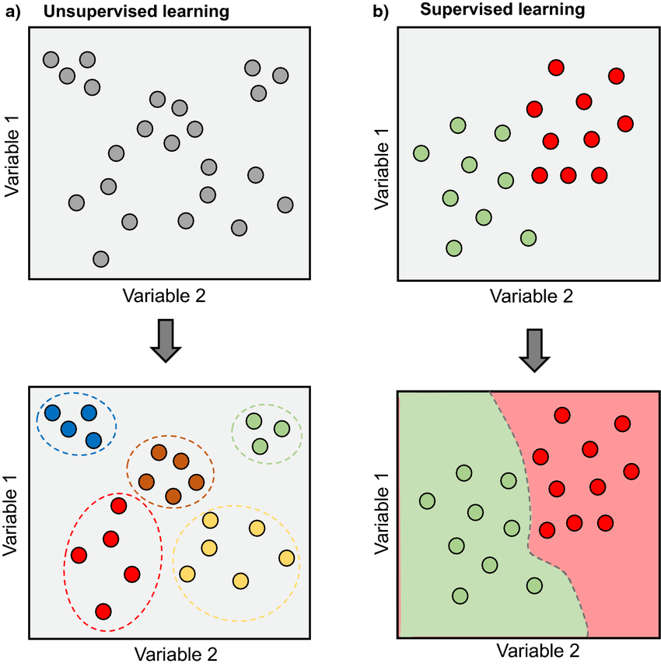
Supervised vs Unsupervised Learning
Definition (Supervised vs. Unsupervised Learning):
Supervised and Unsupervised Learning are the two techniques of machine learning.
The main difference is the need for labelled training data:
Supervised machine learning relies on labelled input and output data to learn and make predictions,
while unsupervised learning does not require labelled data.

Slide 38

Supervised Learning Examples
Examples of supervised learning: spam detection, text classification, predicting the stock market, etc.

Slide 39
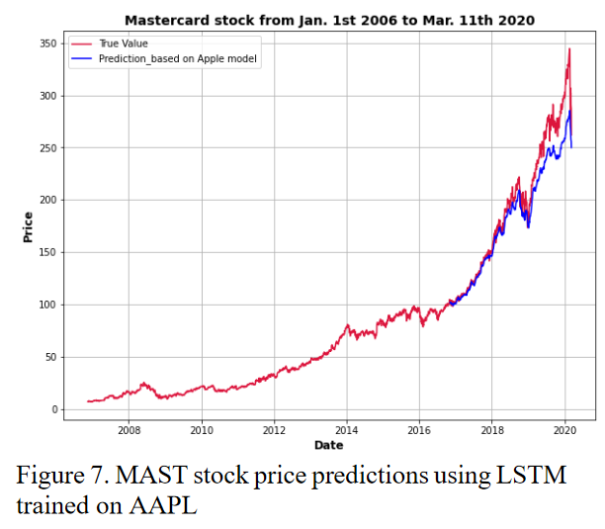
Supervised Learning Examples
Examples of supervised learning: spam detection, text classification, predicting the stock market, etc.

Slide 40
Regression vs. Classification
Definition (Regression):
Regression models are used to identify the relationships between the input and output variables.
Regression algorithms are used to predict continuous values such as price, salary, age, etc.
In regression, the outputs are often continuous numerical values.

Slide 41
Regression vs. Classification (Supervised)
Definition (Classification):
Classification models are used to divide the samples in the dataset into different classes.
Classification algorithms are then used to predict/classify discrete values, such as Male or Female, True or False, Spam or Not Spam, etc.
In Classification, the outputs are discrete or categorical values.

Slide 42
Supervised Learning Examples
Example: predicting the market.
Question: is it a regression or a classification task?

Slide 43
Supervised Learning Examples
Example: predicting the market.
Question: is it a regression or a classification task?
Depends.
If the output we are predicting is the value of the stock in the future, then probably regression.

Slide 44
Supervised Learning Examples
Example: predicting the market.
Question: is it a regression or a classification task?
Depends.
If the output we are predicting is the value of the stock in the future, then probably regression.
If the plan is to predict whether we should buy, sell or wait, then probably classification.

Slide 45
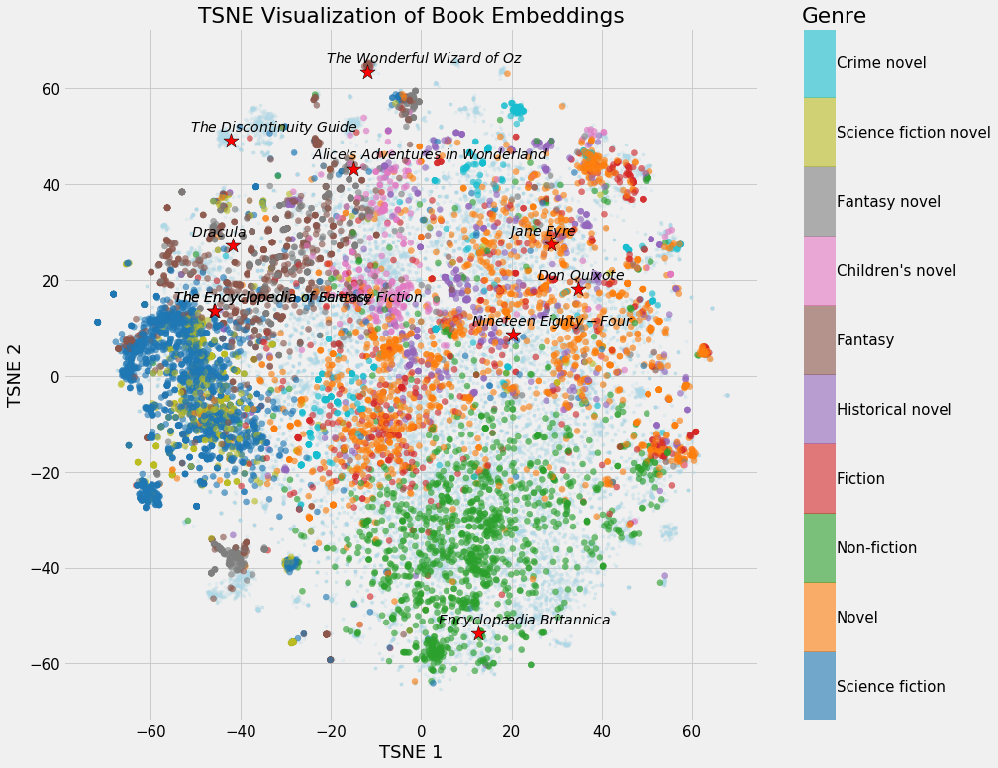
Unsupervised Learning Examples
Examples of unsupervised learning: clustering customers based on their behaviors, segmenting images, and identifying topics in a document.

Slide 46
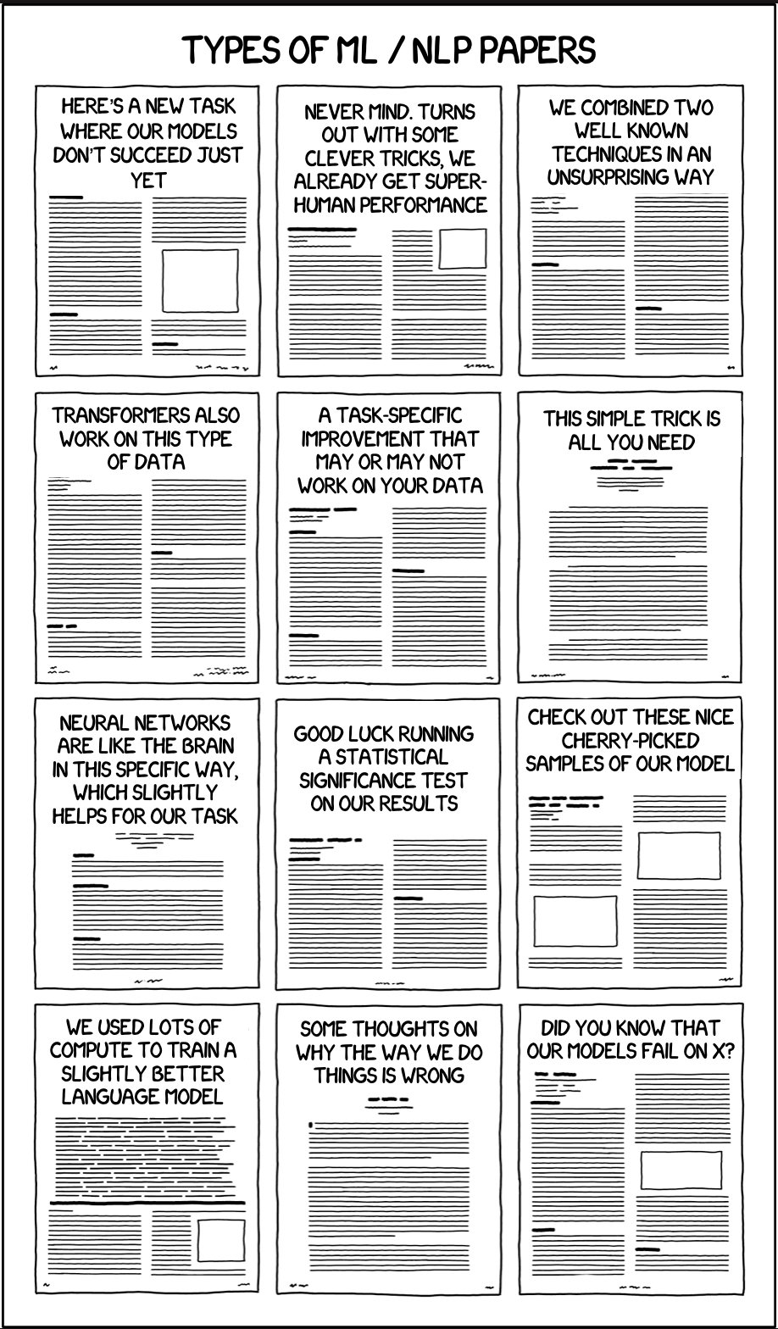
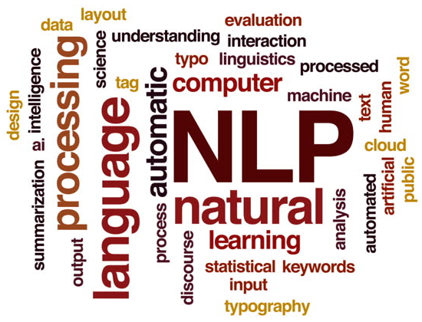
Unsupervised Learning Examples
Identify topics that seem to appear in those papers and their prominence
Examples of unsupervised learning: clustering customers based on their behaviors, segmenting images, and identifying topics in a document.

Slide 47
Clustering vs. Association (Unsupervised)
Definition (Clustering vs. Association):
Unsupervised learning can be used for two types of problems: Clustering and Association.
The main difference
clustering groups data based on similarity,
while association looks for relationships between variables.

Slide 48
Clustering vs. Association (Unsupervised)
Examples of clustering:
Group customers into clusters based on the similarities in their purchasing behaviors, such as their spending habits or types of products they like.
Group the catalog of movies available on Netflix and identify what movies have in common, so you can later recommend a movie to a user based on what he/she has seen before.

Slide 49
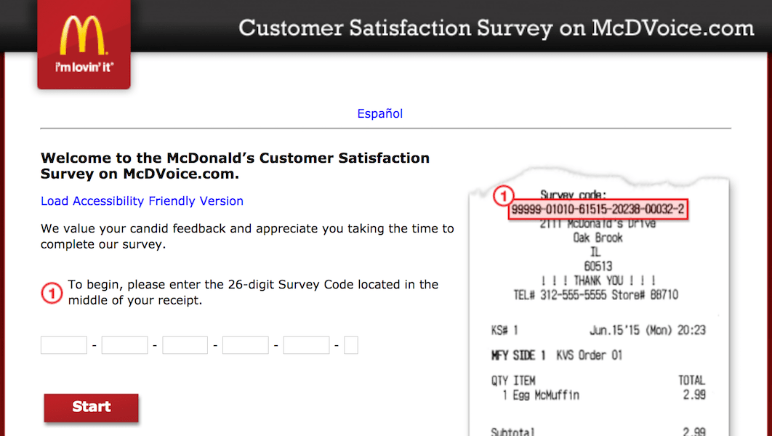

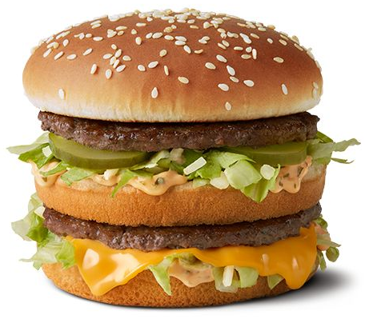

Clustering vs. Association (Unsupervised)
Example of association:
Finding the relationship between customer buying behaviors and customer satisfaction.
Association can be used to understand how changes in customer behavior impacts customer satisfaction, such as if buying a certain product increases customer satisfaction (or the opposite).

Slide 50
Deep Learning and Supervised/Unsupervised
While it is possible to use Deep Learning models and Neural Networks to perform both Supervised and Unsupervised tasks…
The vast majority of DL/NN tasks fall in the category of supervised learning.
(And we will therefore mostly focus on that)

Slide 51
Elements of a ML problem
Definition (Elements of a Machine Learning problem):
Machine learning problems should be well-defined, i.e. the following elements must be clearly identified:
Task (T) at hand,
Inputs (I) and Ouputs (O),
Model (M) definition and its trainable parameters (P),
Loss (L) function to measure the performance on said task and dataset.

Slide 52
Elements of a ML problem
In the example on the right…
Task (T) at hand:
Predict price of an apartment based on the apartment features.
Using a dataset consisting of previously seen appartments to learn the selling prices of apartments.
It is therefore a supervised regression task.

Slide 53
Elements of a ML problem
In the example on the right…
Inputs (I) and Ouputs (O):
Inputs will be a list of apartment features (e.g. number of bathrooms, number of bedrooms, surface size, etc.).
Output will be the selling price in SGD or surface price in SGD per sqft.

Slide 54
Elements of a ML problem
In the example on the right…
Model (M) definition and its trainable parameters (P):
Could be a linear or polynomial regression model (to be discussed this week). Or a neural network of some sort. Or even something else (check your ML course!)
Loss (L) function to measure the performance on said task and dataset:
To be discussed later, as this might depend on the model used.

Slide 55
Our first toy example
Our first toy example: simplified version of the apartment price prediction.
Task (T) at hand:
Predict price of an apartment based on the apartment features.
We will generate a “fake” dataset consisting of appartments with features and selling prices.
Supervised regression task.

Slide 56
Our first toy example
Our first toy example: simplified version of the apartment price prediction.
Inputs (I) and Ouputs (O):
Inputs will be a list of apartment features, which here will only consist of the surface of the apartment, in square meters (sqm).
Output will be the selling price in millions of SGD (mSGD).

Slide 57
Our first toy example (mock dataset)
Have a look at Week 1, Notebook 1.
We will create a dataset, which uses surfaces as inputs, with values drawn randomly between 40 and 150 sqm.
We will assume that the price is randomly generated, using a uniform distribution, with
average 100000 + 14373 times the surface in sqm,
and a "variance" of +/- 10% around the average value.

Slide 58
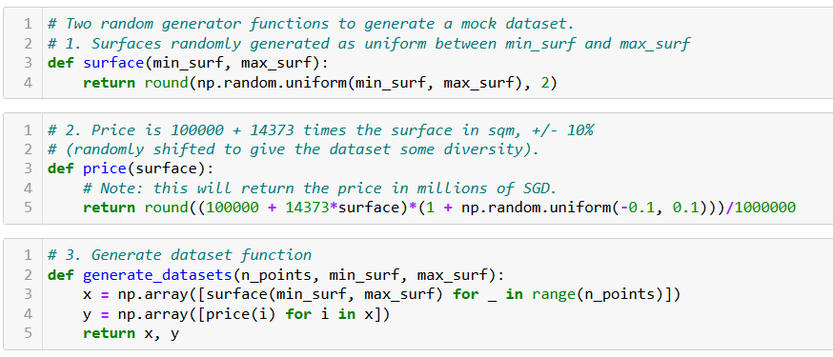
Our first toy example (mock dataset)

Slide 59
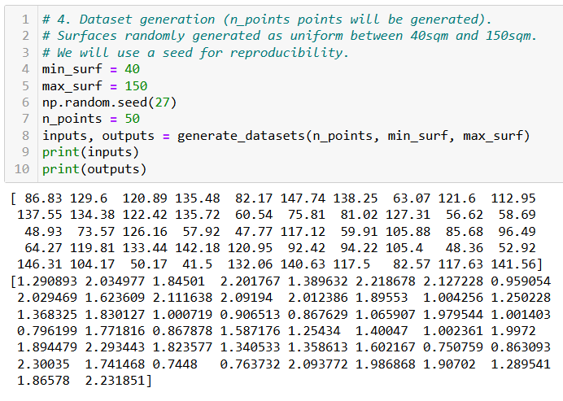
Our first toy example (mock dataset)

Slide 60
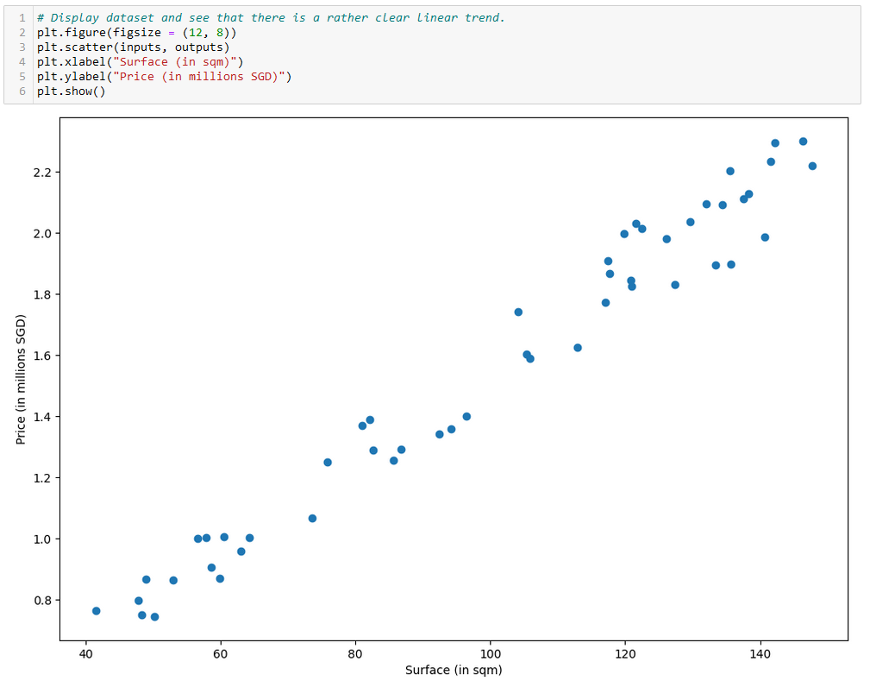

Slide 61
Our first toy example
Our first toy example: simplified version of the apartment price prediction.
Model (M) definition and its trainable parameters (P):
Here, our model will consist of a linear regression model.

Slide 62
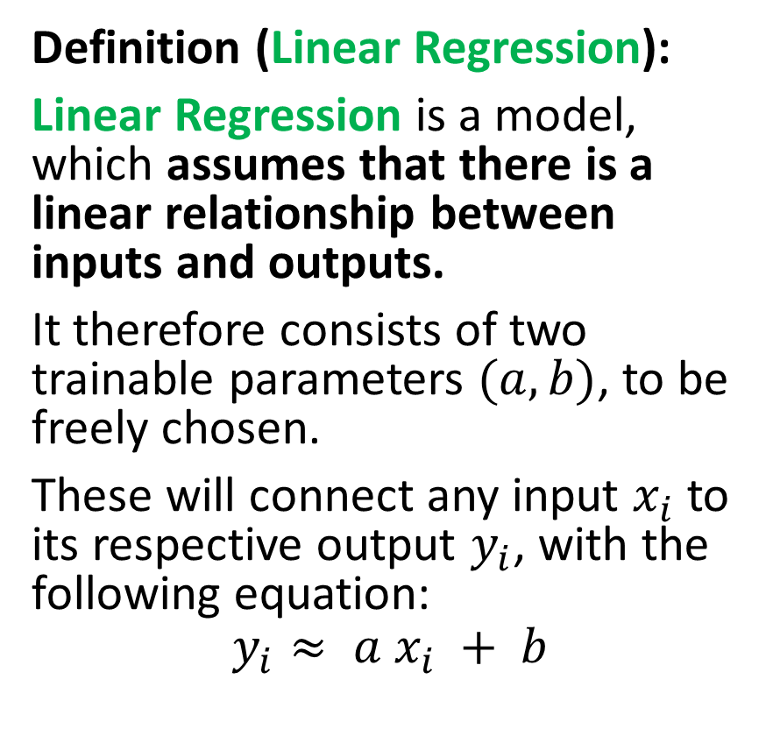
Our first model, the linear regression
Definition (Linear Regression):
Linear Regression is a model, which assumes that there is a linear relationship between inputs and outputs.
It therefore consists of two trainable parameters $(a, b)$, to be freely chosen.
These will connect any input $x_{i}$ to its respective output $y_{i}$, with the following equation:
$$y_{i}≈ a x_{i} + b$$

Slide 63
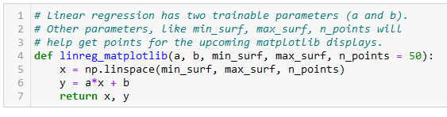
Our first model, the linear regression
Definition (Linear Regression):
Linear Regression is a model, which assumes that there is a linear relationship between inputs and outputs.
It therefore consists of two trainable parameters $(a, b)$, to be freely chosen.
These will connect any input $x_{i}$ to its respective output $y_{i}$, with the following equation:
$$y_{i}≈ a x_{i} + b$$

Slide 64
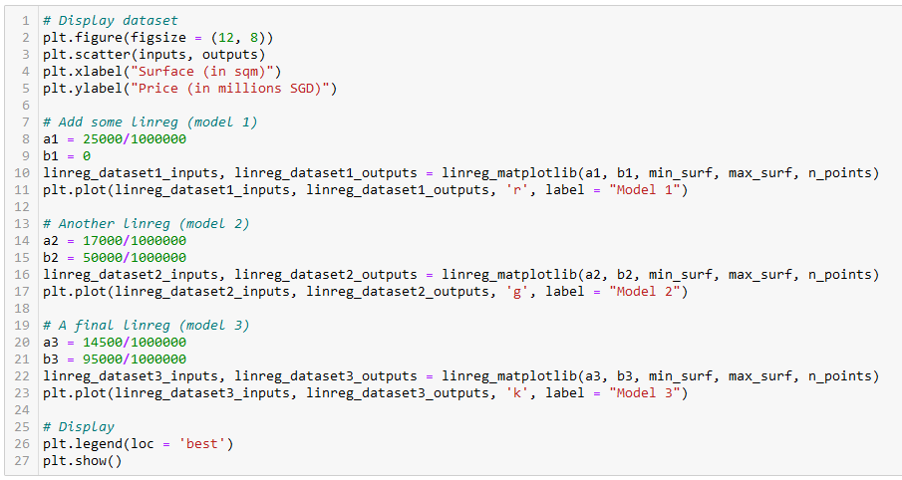
Let us try different values of (a, b)
Model 1
Model 2
Model 3

Slide 65
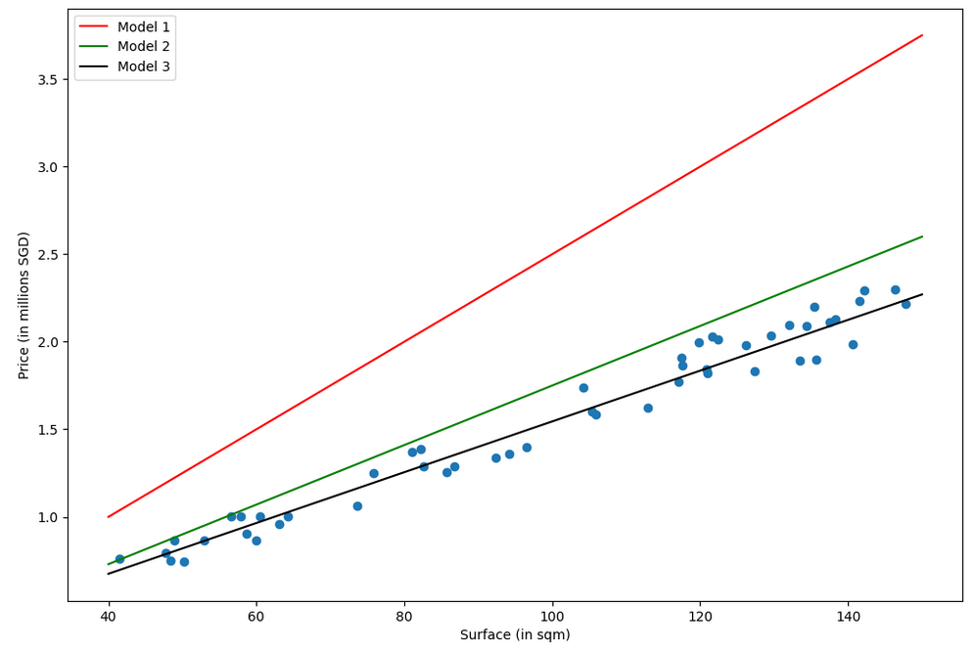
Which model is best in your opinion? (red, green or black)
Why is one better than another?

Slide 66
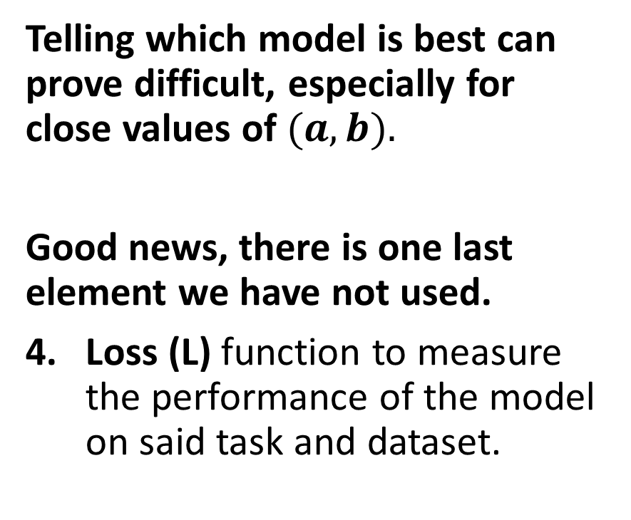
The need for a loss function
Which model is best in your opinion? (red, green or black)
Why is one better than another?
Telling which model is best can prove difficult, especially for close values of $(a, b).$
Good news, there is one last element we have not used.
Loss (L) function to measure the performance of the model on said task and dataset.

Slide 67
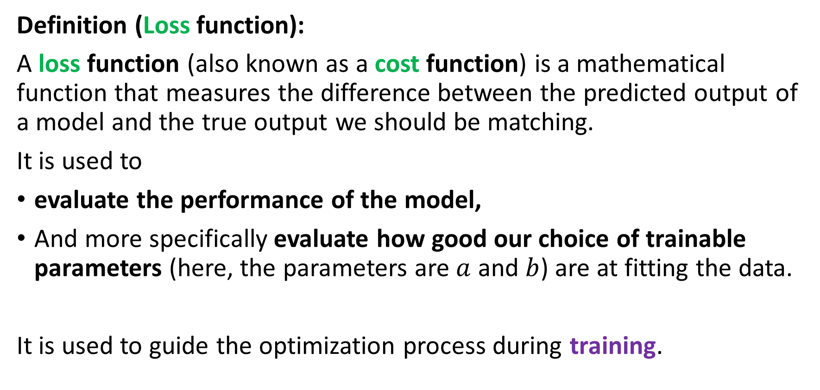
The need for a loss function
Definition (Loss function):
A loss function (also known as a cost function) is a mathematical function that measures the difference between the predicted output of a model and the true output we should be matching.
It is used to
evaluate the performance of the model,
And more specifically evaluate how good our choice of trainable parameters (here, the parameters are $a$ and $b$) are at fitting the data.
It is used to guide the optimization process during training.

Slide 68
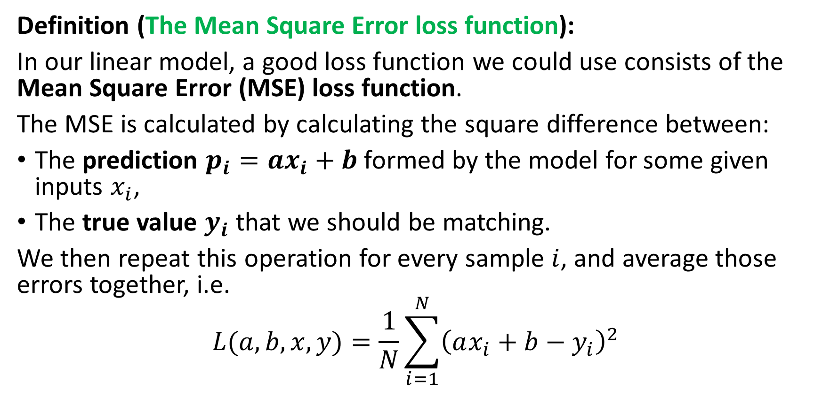
The need for a loss function
Definition (The Mean Square Error loss function):
In our linear model, a good loss function we could use consists of the Mean Square Error (MSE) loss function.
The MSE is calculated by calculating the square difference between:
The prediction $p_{i}=ax_{i}+b$formed by the model for some given inputs $x_{i}$,
The true value $y_{i}$ that we should be matching.
We then repeat this operation for every sample $i$, and average those errors together, i.e.
$$L(a, b,x, y)=\frac{1}{N}\sum_{i=1}^{N}{{\left(ax_{i}+b−y_{i}\right)}^{2}}$$

Slide 69
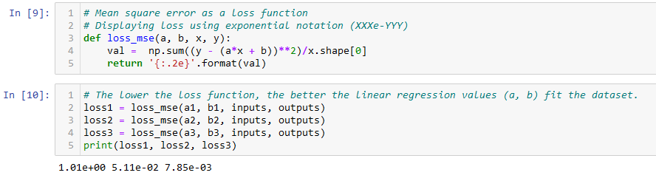
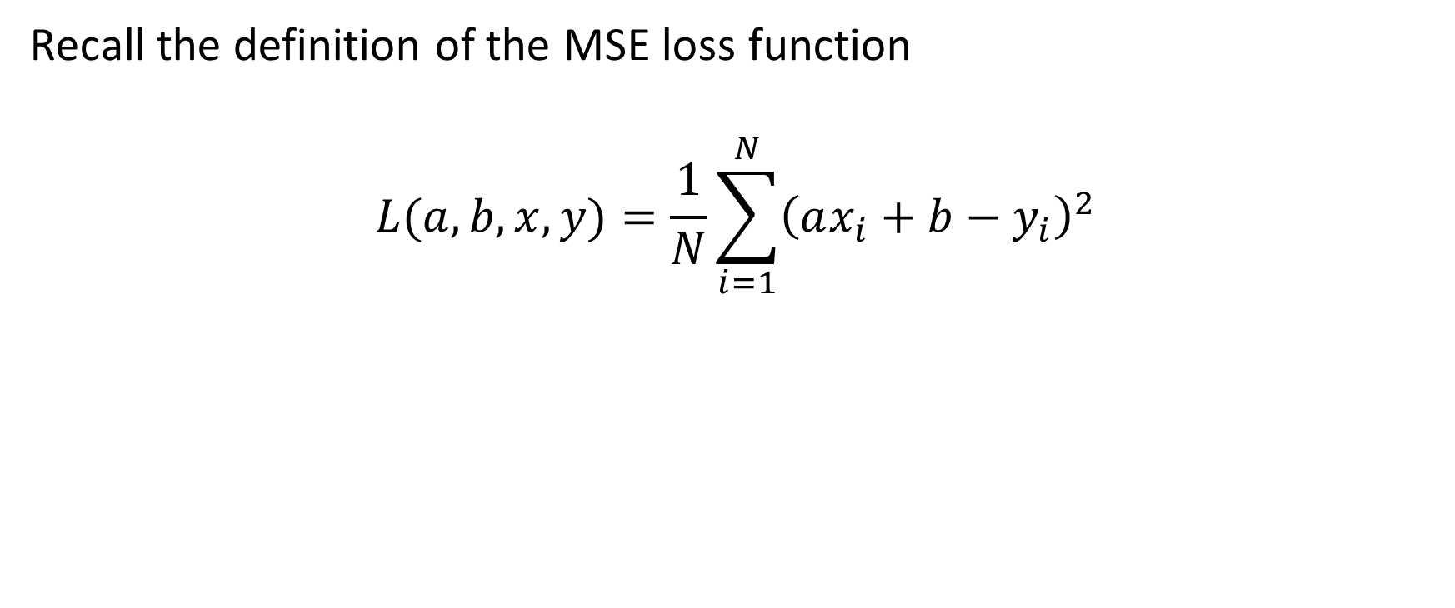
The need for a loss function
Recall the definition of the MSE loss function
$$L(a, b,x, y)=\frac{1}{N}\sum_{i=1}^{N}{{\left(ax_{i}+b−y_{i}\right)}^{2}}$$

Slide 70
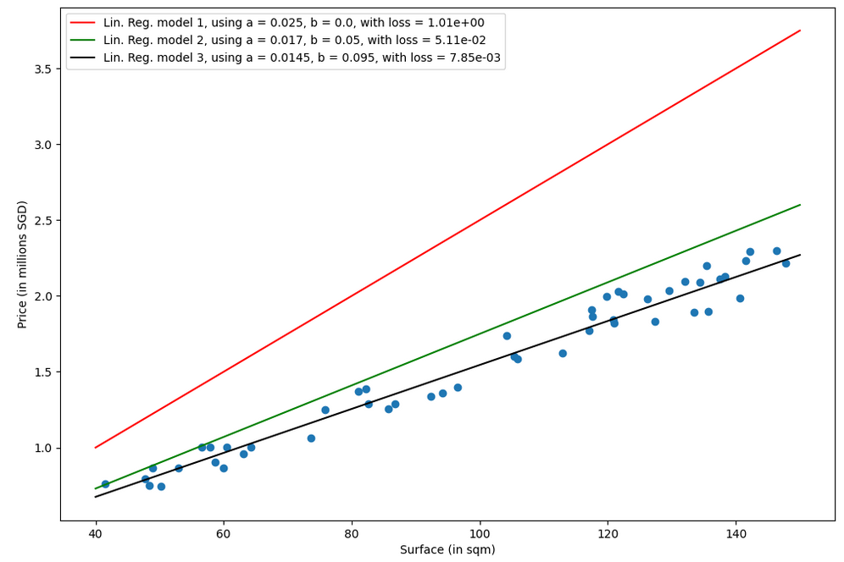

Slide 71
Training a model
Definition (Training a model):
Training a model consists of finding the best values for the trainable parameters of the chosen model, for the given task and dataset.
The goal of training is to find the set of model parameters that minimize the loss function. Once a minimal value is obtained on the loss function, then we can claim that the “optimal” trainable parameters have been found (or in other word, the model has been trained).

Slide 72
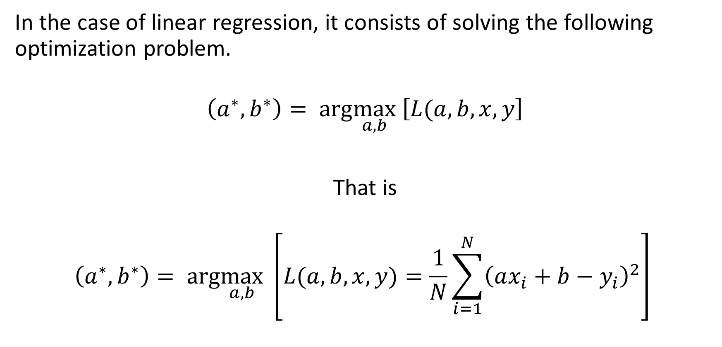
Training a linear regression model
In the case of linear regression, it consists of solving the following optimization problem.
$$\left(a^{∗},b^{∗}\right)= arg\max_{a,b} \left[L(a, b,x, y\right]$$
That is
$$\left(a^{∗},b^{∗}\right)= arg\max_{a,b} \left[L(a, b,x, y)=\frac{1}{N}\sum_{i=1}^{N}{{\left(ax_{i}+b−y_{i}\right)}^{2}}\right]$$

Slide 73
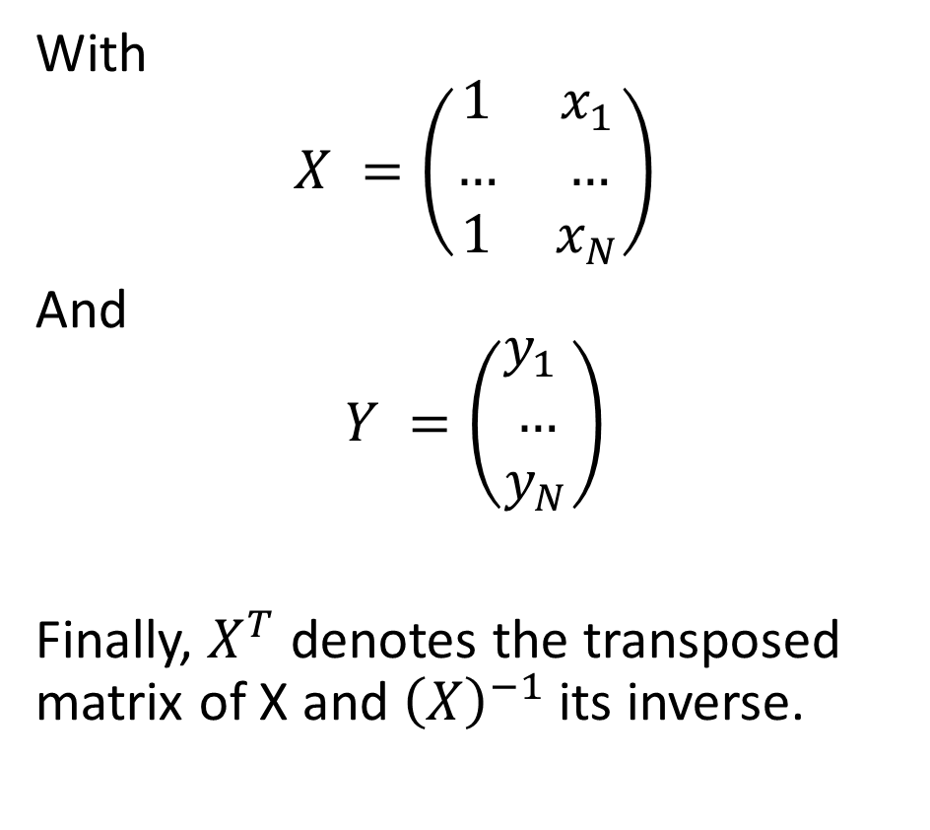
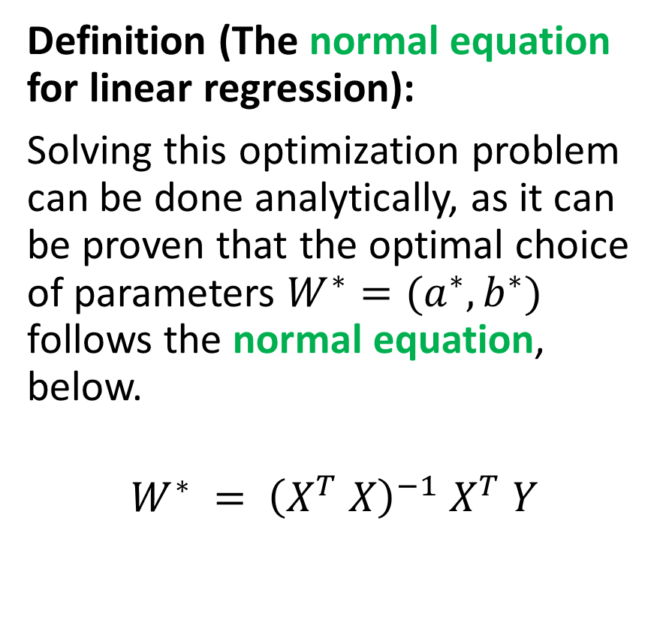
Training a linear regression model
Definition (The normal equation for linear regression):
Solving this optimization problem can be done analytically, as it can be proven that the optimal choice of parameters $W^{∗}=(a^{∗},b^{∗})$ follows the normal equation, below.
$$W^{∗} = {\left(X^{T} X\right)}^{−1} X^{T} Y$$
With
$$X =\left(\begin{matrix}1 & x_{1} \\ … & … \\ 1 & x_{N}\end{matrix}\right)$$
And
$$Y =\left(\begin{matrix}y_{1} \\ … \\ y_{N}\end{matrix}\right)$$
Finally, $X^{T}$ denotes the transposed matrix of X and ${\left(X\right)}^{−1}$its inverse.

Slide 74
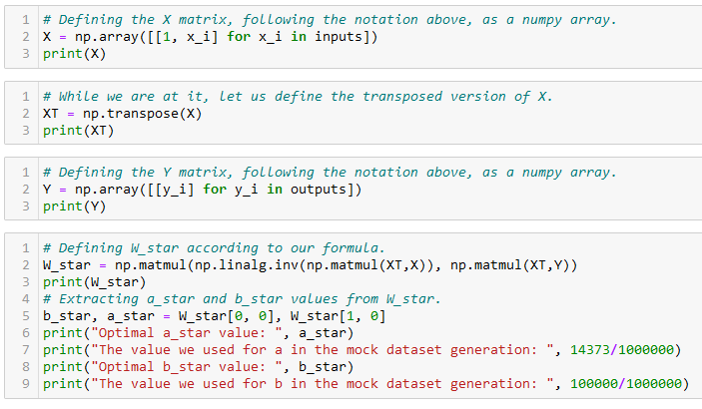
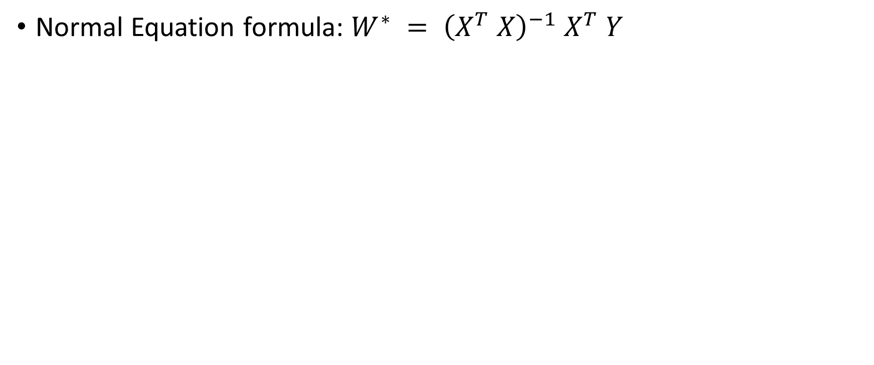
Training a linear regression model
Normal Equation formula: $W^{∗} = {\left(X^{T} X\right)}^{−1} X^{T} Y$

Slide 75
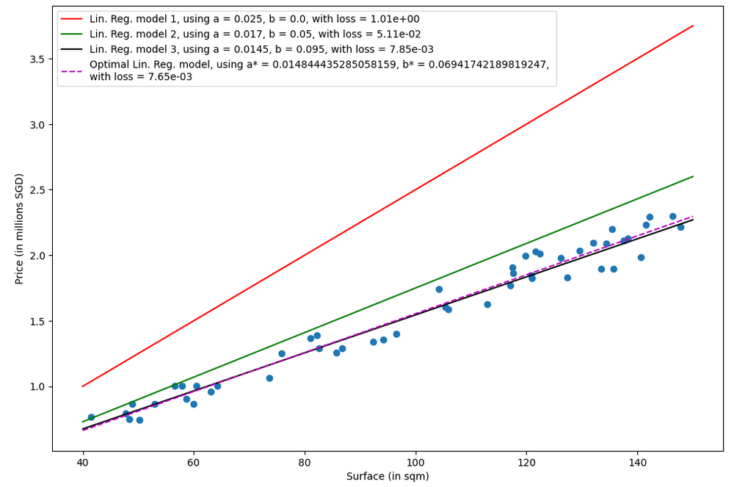

Slide 76
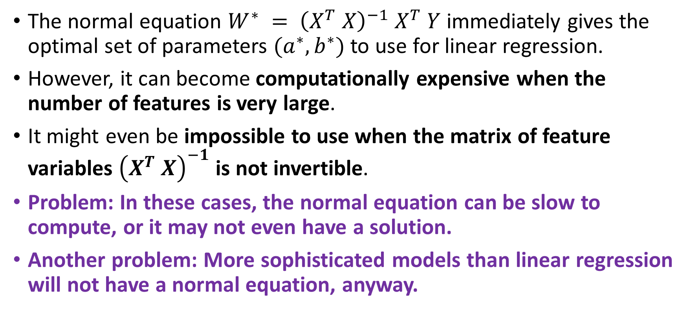
A problem with the normal equation
The normal equation $W^{∗} = {\left(X^{T} X\right)}^{−1} X^{T} Y$immediately gives the optimal set of parameters $(a^{∗}, b^{∗})$to use for linear regression.
However, it can become computationally expensive when the number of features is very large.
It might even be impossible to use when the matrix of feature variables ${\left(X^{T} X\right)}^{−1}$ is not invertible.
Problem: In these cases, the normal equation can be slow to compute, or it may not even have a solution.
Another problem: More sophisticated models than linear regression will not have a normal equation, anyway.

Slide 77
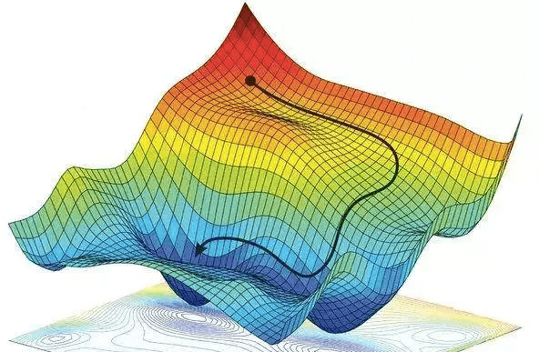
Gradient Descent, to the rescue!
Definition (Gradient Descent):
Gradient Descent (GD) is an iterative algorithm used to solve optimization problems.
It starts with an initial set of parameters.
It then repeatedly updates the parameters in the direction of the negative gradient of the given cost function, until it converges to a local minimum.
Forgot about GD? Have a look at your notes from 10.013 M&A!

Slide 78
Gradient Descent, to the rescue!
Definition (Gradient Descent):
Gradient Descent (GD) is an iterative algorithm used to solve optimization problems.
It starts with an initial set of parameters.
It then repeatedly updates the parameters in the direction of the negative gradient of the given cost function, until it converges to a local minimum.
The normal equation has many problems…
But GD, on the other hand can be used to find the optimal solution even when the normal equation is not applicable.
The main advantage of gradient descent is that it can handle very large datasets and it can also be used for non-linear models.

Slide 79
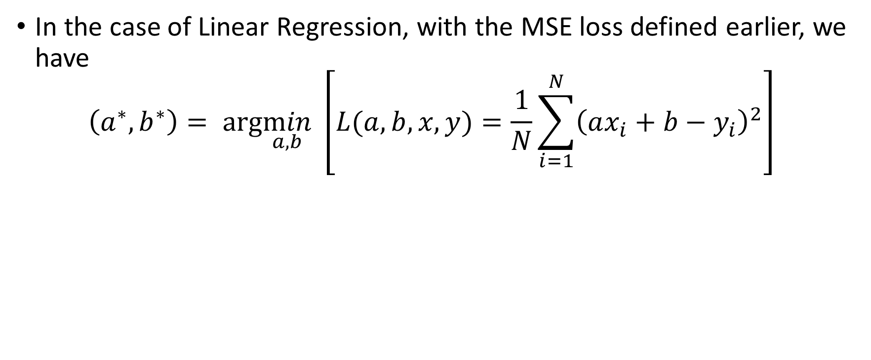
GD in Linear Regression
In the case of Linear Regression, with the MSE loss defined earlier, we have
$$\left(a^{∗},b^{∗}\right)= arg\min_{a,b} \left[L(a, b,x, y)=\frac{1}{N}\sum_{i=1}^{N}{{\left(ax_{i}+b−y_{i}\right)}^{2}}\right]$$

Slide 80
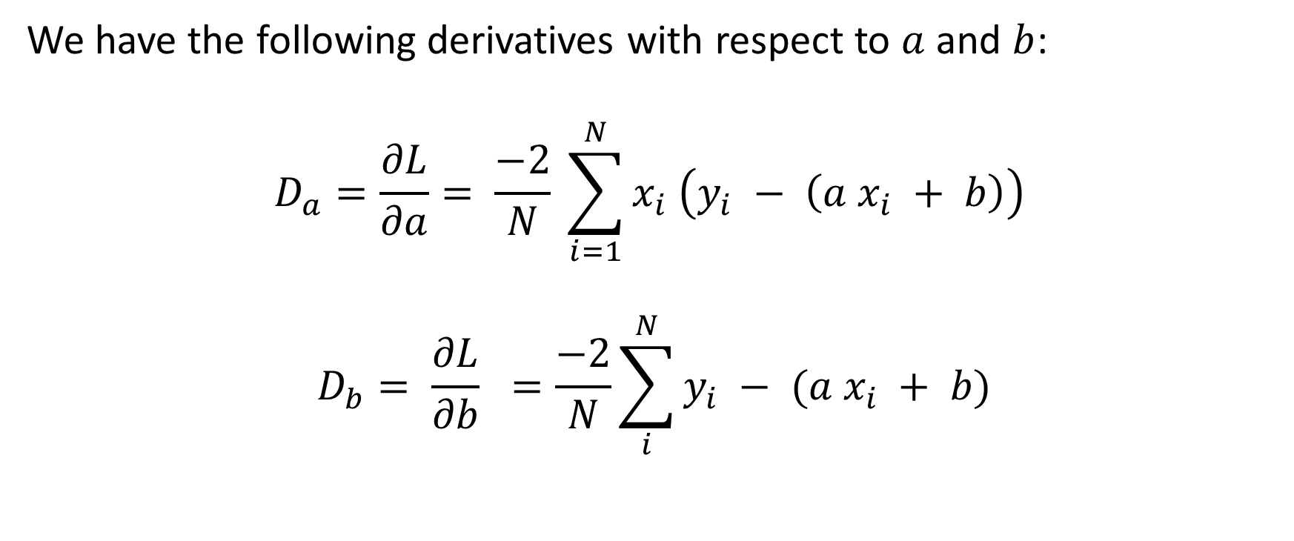
GD in Linear Regression
We have the following derivatives with respect to $a$ and $b$:
$$D_{a}=\frac{∂L}{∂a}= \frac{−2}{N} \sum_{i=1}^{N}{x_{i} \left(y_{i} − \left(a x_{i} + b\right)\right)}$$
$$D_{b}= \frac{∂L}{∂b} =\frac{−2}{N}\sum_{i}^{N}{y_{i} − (a x_{i} + b)}$$

Slide 81
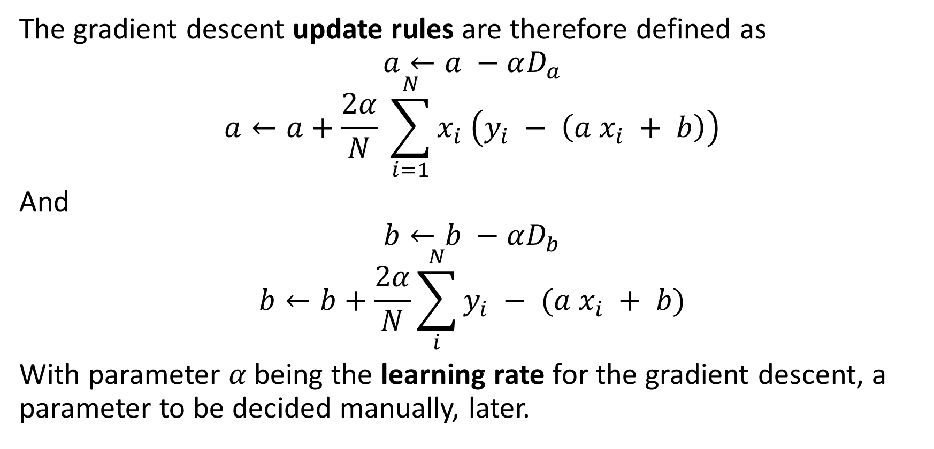
GD in Linear Regression
The gradient descent update rules are therefore defined as
$$a←a −αD_{a}$$
$$a←a+\frac{2α}{N} \sum_{i=1}^{N}{x_{i} \left(y_{i} − \left(a x_{i} + b\right)\right)}$$
And
$$b←b −αD_{b}$$
$$b←b+\frac{2α}{N}\sum_{i}^{N}{y_{i} − (a x_{i} + b)}$$
With parameter 𝛼 being the learning rate for the gradient descent, a parameter to be decided manually, later.

Slide 82
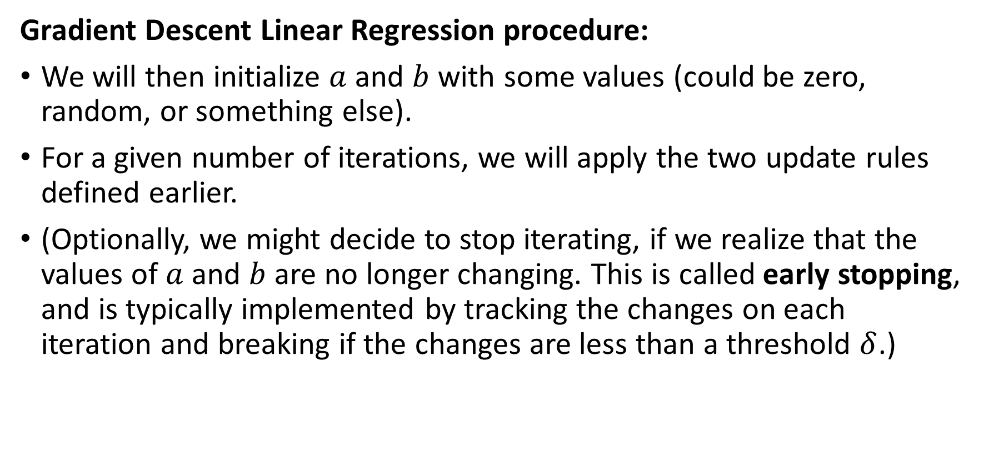
GD in Linear Regression
Gradient Descent Linear Regression procedure:
We will then initialize $a$ and $b$ with some values (could be zero, random, or something else).
For a given number of iterations, we will apply the two update rules defined earlier.
(Optionally, we might decide to stop iterating, if we realize that the values of $a$ and $b$ are no longer changing. This is called early stopping, and is typically implemented by tracking the changes on each iteration and breaking if the changes are less than a threshold $δ$.)

Slide 83
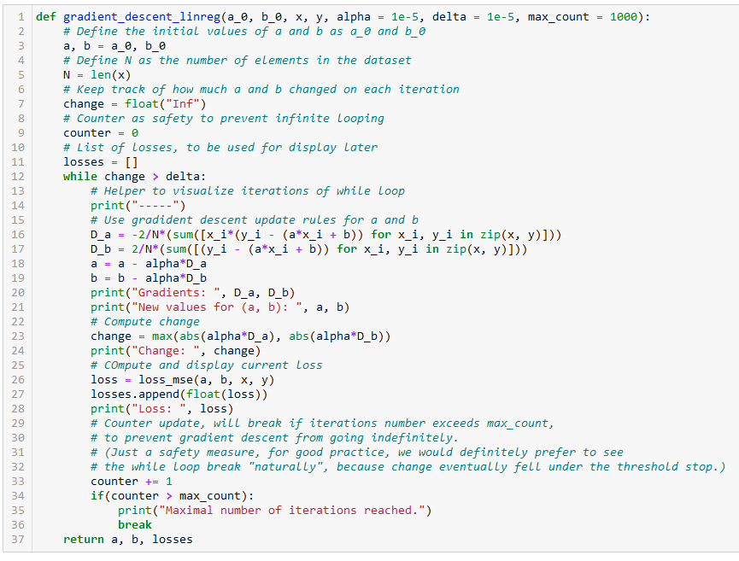
Initialize a and b as you please.

Slide 84
Number of samples in dataset.

Slide 85
Two possible stopping conditions, change < delta or counter > max_count

Slide 86
Update using our GD update rules from earlier

Slide 87
Compute change on this iteration (to decide on early stopping or not)

Slide 88
Calculate new MSE value using the new parameters a and b. We also keep track of these losses for display later

Slide 89
Return trained parameters and losses evolution on each iteration

Slide 90
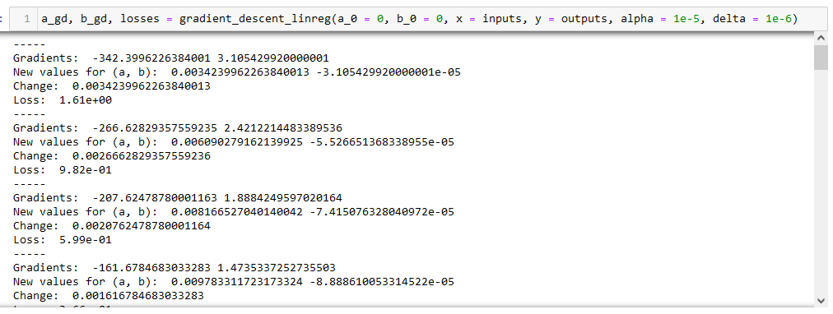

Slide 91
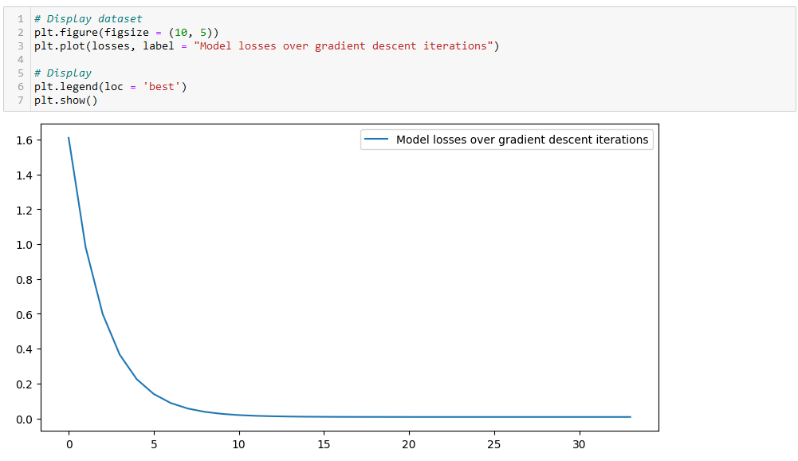

Slide 92

Checking for optimal parameters
We have generated the dataset ourselves, so we know what should be the values for a and b!

Slide 93


Slide 94

Using Sklearn for Linear regression
In practice, we never implement the linear regression model ourselves (but it is a good practice to try it at least once!)
It is often faster to rely on the sklearn library and use the LinearRegression object!

Slide 95

Predicting using Sklearn Linear regression
After training, it is also good practice to check if the predictor makes sense, by asking it to predict the price of an apartment it has never seen before.
Confirm the value manually, if possible.

Slide 96

Extension of multi-parameter Linear Regression
Let us now consider that the inputs consist of more than one parameter, e.g. each sample $x_{i}$ consists of:
The surface $x_{i}^{1},$
The distance to closest MRT $x_{i}^{2},$
Etc.
The linear regression can be simply transposed.

Slide 97

Extension of multi-parameter Linear Regression
Definition (Multi-parameter Linear Regression):
Multi-parameter Linear Regression is a model, which assumes that there is a linear relationship between inputs and outputs.
It therefore consists of several trainable parameters $(a_{1, }a_{2},…a_{K},b)$, to be freely chosen.
These will connect any input $x_{i}=\left(x_{i}^{1},x_{i}^{2},…,x_{i}^{K}\right)$ to its respective output $y_{i}$, with the following equation:
$$y_{i}≈\sum_{k=1}^{K}{a_{k} x_{i}^{k}} + b$$

Slide 98

Extension of multi-parameter Linear Regression
The MSE loss then becomes:
$$L=\frac{1}{N}\sum_{i=1}^{N}{{\left(\sum_{k=0}^{K}{a_{k}x_{i}^{k}}+b−y_{i}\right)}^{2}}$$
And the optimization problem related to training is then:
$$\left(a_{0}^{∗},a_{1}^{∗}, …,a_{K}^{∗}, b^{∗}\right)= arg\min_{a_{0},a_{1},…,a_{K},b}L$$

Slide 99

Extension of multi-parameter Linear Regression
We could then compute the new normal equation for this problem (good practice for your optimization skills, try it out!)
Or, we could then define update rules with respect to every trainable parameter $(a_{1, }a_{2},…a_{K},b)$ like before.
However, we leave this implementation for students who would like to practice. (or it might be the homework for this week!)

Slide 100

From Linear to Polynomial Regression
Definition (Polynomial Regression with degree K):
Polynomial Regression is a model, which assumes that there is a polynomial relationship between inputs and outputs, which can be defined as a polynomial function of degree $K$.
It therefore consists of several trainable parameters $(a_{1, }a_{2},…a_{K},b)$, to be freely chosen.
These will connect any input $x_{i}=\left(x_{i}^{1},x_{i}^{2},…,x_{i}^{K}\right)$ to its respective output $y_{i}$, with the following equation:
$$y_{i}≈\sum_{k=1}^{K}{a_{k} {\left(x_{i}\right)}^{k}} + b$$

Slide 101

From Linear to Polynomial Regression
We will follow the same steps as before with linear regression, starting with a mock dataset.
This will be different compared than what has been implemented in notebooks 1 and 2, as we will generate prices $y_{i}$ as a polynomial function of the surfaces $x_{i}$.
We will assume that the function $y=f(x)$, giving the price of an apartment with surface $x$, is defined as a polynomial function with degree 3.
$$y=f(x) = 100000 + 14373x + 3x^{3}$$
In addition, we will add a random noise to the final pricing, with a +/- 10% drift as before.

Slide 102

From Linear to Polynomial Regression
We will follow the same steps as before with linear regression, starting with a mock dataset.
This will be different compared than what has been implemented in notebooks 1 and 2, as we will generate prices $y_{i}$ as a polynomial function of the surfaces $x_{i}$.
We will assume that the function $y=f(x)$, giving the price of an apartment with surface $x$, is defined as a polynomial function with degree 3.
$$y=f(x) = 100000 + 14373x + 3x^{3}$$
In addition, we will add a random noise to the final pricing, with a +/- 10% drift as before.

Slide 103

From Linear to Polynomial Regression

Slide 104

Data no longer shows linearity, which is expected.
Using a Linear Regressor would be a mistake, as it would not properly fit the data.

Slide 105


Polynomial Regression with sklearn
Sklearn treats polynomial regression as a multi-parameter linear regression, with polynomial features.
Polynomial features: reworking the inputs so that
$$\tilde{X}=\left(\begin{matrix}x_{1} & ⋯ & {\left(x_{1}\right)}^{K} \\ ⋮ & ⋱ & ⋮ \\ x_{N} & ⋯ & {\left(x_{N}\right)}^{K}\end{matrix}\right)$$
And ${\tilde{x}}_{i,j}={\left(x_{i}\right)}^{j}$

Slide 106


Polynomial Regression with sklearn
We then proceed normally, assuming $\tilde{X}$ are our new inputs.
Sklearn then automatically adjusts and produces the right number of parameters for the model.

Slide 107

A much better fit, with a lower MSE loss

Slide 108

Be careful however on the degree you use for the polynomial regression.
Higher degree is not always better!

Slide 109
Be careful however on the degree you use for the polynomial regression.
Higher degree is not always better!
Red model (high degree) will struggle to predict price of a 150sqm apartment!

Slide 110

Overfitting vs. degree of polynomial
Red curve shows what happens when using a degree $K$ that is too high compared to the relationship connecting inputs and outputs (it was 3).
This phenomenon is called overfitting.

Slide 111
Overfitting vs. degree of polynomial
Definition (Overfitting):
Overfitting is a phenomenon that occurs in machine learning when a model is trained too well on the training data.
As a result, it performs poorly on new, unseen data (here an apartment with 150sqm surface, which we had not in the training dataset).

Slide 112
Overfitting vs. degree of polynomial
Definition (Overfitting):
Overfitting is a phenomenon that occurs in machine learning when a model is trained too well on the training data.
As a result, it performs poorly on new, unseen data (here an apartment with 150sqm surface, which we had not in the training dataset).
This typically happens when
a model is trained with too many features
or too much data,
It becomes too complex for the task at hand, resulting in poor generalization to new data.
In other words, it memorizes the noise in the training data rather than learning the correct underlying pattern.

Slide 113

Underfitting vs. degree of polynomial
Definition (Underfitting):
Underfitting is a phenomenon that occurs in machine learning when a model is not complex enough to capture the underlying pattern of the data.
For instance, here, Linear Regression (which is Polynomial Regression with $K = 1$) could not fit the data well.

Slide 114
Underfitting vs. degree of polynomial
Definition (Underfitting):
Underfitting is a phenomenon that occurs in machine learning when a model is not complex enough to capture the underlying pattern of the data.
For instance, here, Linear Regression (which is Polynomial Regression with $K = 1$) could not fit the data well.
This can happen when a model
is trained with too few features
or too little data,
or when the model is not powerful enough to capture the complexity of the task.

Slide 115
Generalization
Definition (Generalization):
Generalization is considered the "holy grail" of machine learning because it is the ultimate goal of any machine learning model.
Even though the model was trained on seen data we collected, the purpose of a machine learning model is to make accurate predictions on new, unseen data.
If a model can make accurate predictions on data it has not seen before, it is said to have generalized well, and can then be used in the real world for solving the problem it was designed to solve.

Slide 116

Generalization vs. Overfitting/Underfitting
In general, underfitting or overfitting will lead to poor generalization.
We would very much prefer to fit the data “just right”.

Slide 117
While we are at it…
In general, we want to:
Train the model was trained on data we collected,
Confirm that the model can generalize and make accurate predictions on new, unseen data, after training.
Problem: We would prefer to test the model before releasing it in the wild (what if it is wrong?)
Problem #2: Testing its generalization capabilities on the same data that was used for training would NOT confirm generalization.
Solution: Use some of our seen data to train the model, and some of the data (that has not been used for training and is therefore unseen to the model yet) for evaluating its generalization.

Slide 118

Train and test split
Definition (Train and Test Split):
Train and test split is a method used in machine learning to divide a dataset into two subsets:
The training set is used to train the model
The test set is used to evaluate the performance of the trained model.
The idea is to use a portion of the dataset for training and a separate portion for testing so that the model can be evaluated on unseen data.
The typical split is to use 80% of the data for training and 20% for testing.
This can however vary depending on the specific use case and the size of the dataset.

Slide 119

Train and test split

Slide 120


Slide 121

Training the Polynomial Regressor, again
This time, we only train the polynomial regressor on the training data.
After training, evaluate loss using the test data.

Slide 122

Red curve is higher degree polynomial regression. While it seems like it should perform better than black, its test loss is higher!
What could be the reason?

Slide 123
Red curve is higher degree polynomial regression. While it seems like it should perform better than black, its test loss is higher!
What could be the reason?
Bad fitting on low surface apartments!
(No apartment with size less than 45sqm in train dataset!)

Slide 124

Generalization vs. Train/Test Distributions
Definition (The need for train and test distribution similarity):
In order to generalize well in is important that the train and test set are following similar distributions.
$$P_{train}≈P_{test}$$
Here, we ended up having a problem, as our training dataset did not contain any apartments with size lower than 45sqm.
I mean, you would not train a model on Singaporean apartments and use it to predict the price of apartments in Kuala Lumpur, right?

Slide 125
But then, why did black end up being ok then? It had not seen the <45sqm data either!

Slide 126
Regularization
Definition (Regularization):
Regularization consists of helping the model avoid overfitting (which is usually more prominent than underfitting).
It can typically be done by making sure the model is not too complex for the data, but many other approaches exist.
In general,
the more complex the data is (in terms of features), the more complex the model can be.
the more data you have (in terms of quantity of individual samples in dataset), the more complex the model can be.

Slide 127

Regularization
Definition (Regularization):
Regularization consists of helping the model avoid overfitting (which is usually more prominent than underfitting).
It can typically be done by making sure the model is not too complex for the data, but many other approaches exist.
A more common approach consists of adding a penalty term to the loss function.
The penalty term, also known as a regularization term, discourages the model from assigning too much weight to any one feature, i.e. making a certain parameter $a_{k}$ too prominent (leading to overfitting).

Slide 128


Regularization
Definition (Ridge Regression):
The Ridge Polynomial Regressor is a polynomial regressor, like described earlier.
Its only difference is the loss function includes an additional regularization term $λ R(a, b)$.
This regularization term consists of the sum of the squared values for the trainable parameters, i.e.:
$$λ R\left(a, b\right)=\frac{λ}{2N}\left( \sum_{k}^{M}{{ \left(a_{k}\right)}^{2}} + {\left(b\right)}^{2}\right)$$
This regularization term encourages the model to assign low values to the coefficients of the model.
This will, in turn, lead to less overfitting. Indeed, overfitting often occurs when high values are assigned to coefficients for high degrees (i.e. coefficients $a_{k}$with for high $k$ values).

Slide 129


Slide 130

Regularization
Definition (Ridge Regression):
The Ridge Polynomial Regressor is a polynomial regressor, like described earlier.
Its only difference is the loss function includes an additional regularization term $λ R(a, b)$.
This regularization term consists of the sum of the squared values for the trainable parameters, i.e.:
$$λ R\left(a, b\right)=\frac{λ}{2N}\left( \sum_{k}^{M}{{ \left(a_{k}\right)}^{2}} + {\left(b\right)}^{2}\right)$$
Note: Just like the learning rate in GD, the parameter $λ$ is manually decided and is used to weight the importance of the regularization term compared to the MSE.
If the value for 𝜆 is small, the loss function will be mostly MSE and our model will therefore suffer from the same overfitting problems as earlier.
If the value of 𝜆 is too high however, the model will mostly ignore the MSE part of the loss function, which will lead to a model not fitting (or underfitting) the data.

Slide 131


Slide 132
Regularization
Definition (Ridge Regression):
The Ridge Polynomial Regressor is a polynomial regressor, like described earlier.
Its only difference is the loss function includes an additional regularization term $λ R(a, b)$.
This regularization term consists of the sum of the squared values for the trainable parameters, i.e.:
$$λ R\left(a, b\right)=\frac{λ}{2N}\left( \sum_{k}^{M}{{ \left(a_{k}\right)}^{2}} + {\left(b\right)}^{2}\right)$$
Note #2: it is also possible to use the sum of absolute values, making a Lasso Regressor instead.
Note #3: it is also possible to use the sum of absolute values AND squared values, making an Elastic Regressor instead.
Check it out!

Slide 140
Conclusion (W1S1)
XXX
XXX

Slide 141
Learn more about these topics
Out of class, supporting papers, for those of you who are curious.
[XXX] XXX

Slide 142
Learn more about these topics
Some extra (easy) reading and videos for those of you who are curious.
[XXX] XXX

